Slide 1
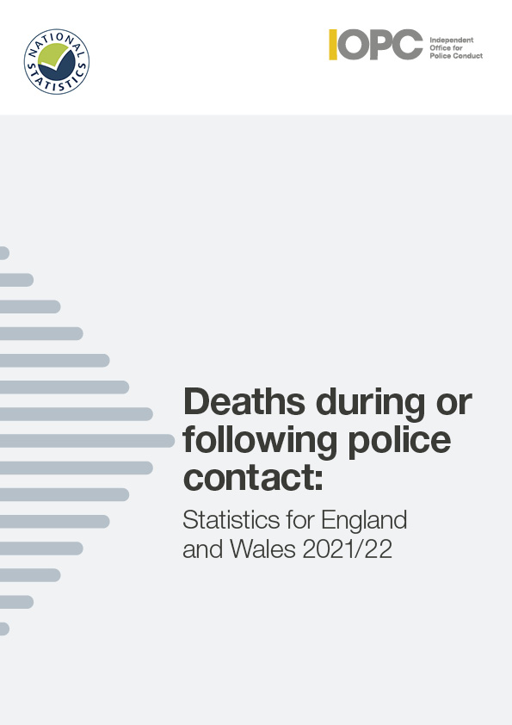


Slide 2
Introduction
This report presents figures on deaths during or following police contact that happened between 1 April 2021 and 31 March 2022. It provides a definitive set of figures for England and Wales, and an overview of the nature and circumstances in which these deaths occurred.
It is the eighteenth in a series of statistical reports on this subject, published annually by the IOPC, formerly the Independent Police Complaints Commission (IPCC).

Slide 3
Introduction
To produce these statistics, we examine the circumstances of all deaths that are referred to us. We decide whether the deaths meet the criteria for inclusion in this report under one of the following categories:
road traffic fatalities
fatal shootings
deaths in or following police custody
apparent suicides following police custody
other deaths following police contact that were subject to an independent investigation
Notes:
Police forces have a statutory duty to refer all incidents involving a death or serious injury to us.
This report is part of our statutory remit and highlights the importance of having in place robust systems of investigation, learning and accountability, which follow deaths following contact with police

Slide 4

National statistics
The UK Statistics Authority has designated these statistics as National Statistics.
This designation means that the statistics:
meet identified user needs
are well explained and readily accessible
are produced according to sound methods
are managed impartially and objectively in the public interest

Slide 5
Overall findings
During 2021/22, in each category there were:
  39 road traffic fatalities
  2 fatal police shootings
  11 deaths in or following police custody
  56 apparent suicides following police custody
  109 other deaths following police contact that were independently investigated by the IOPC

Slide 6
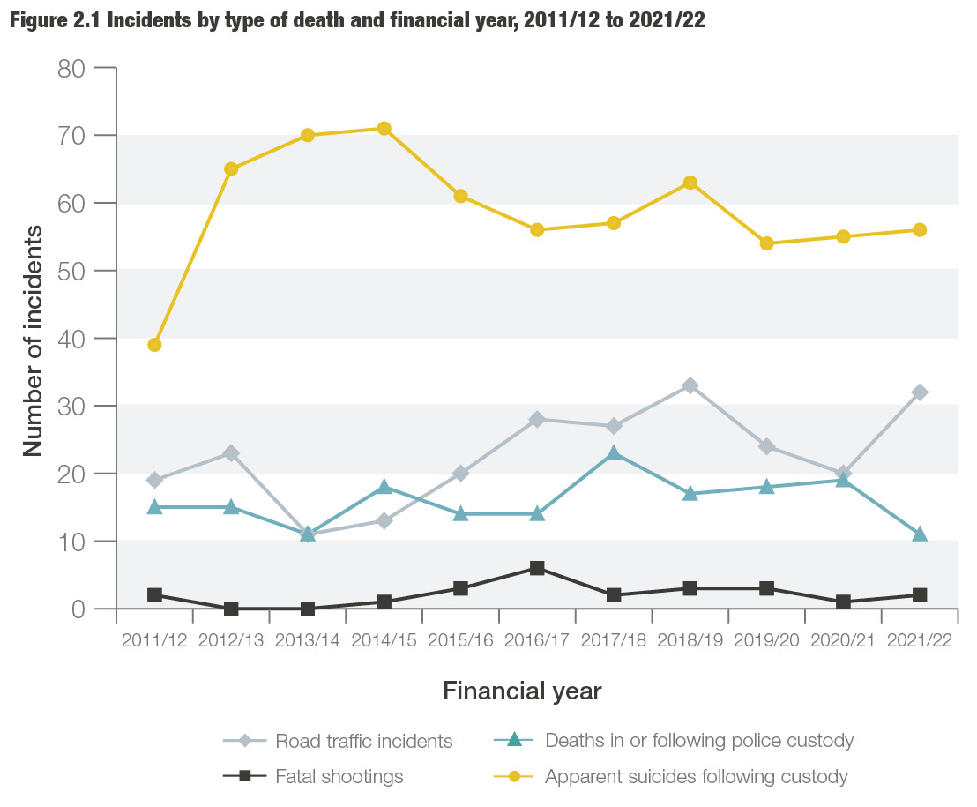
Notes:
This graph shows the change in numbers of incidents by type of death from 2011/12 to 2021/22. We will explore this further as we go through the next few slides.

Slide 7
Key findings
Deaths in or following police custody
This year there were 11 deaths in or following police custody. This is the joint lowest figure since 2004/05 and lower than the average figure for over the last decade.
Four people had some force used against them by officers or by members of the public before their deaths, although the use of force did not necessarily contribute to their death.
Of the 11 deaths in or following police custody, ten people were White, and one was Black.
Three deaths took place within a police custody suite. There were no apparent suicides while in a police custody suite.
Notes:
Between 2004/05 and 2008/09, there was a year-on-year reduction in the number of deaths in or following police custody. These deaths reduced from 36 in 2004/05 to 15 deaths in 2008/09. Over the next two years, the number of deaths in custody increased to 21 in 2010/11, before reducing to 15 in 2011/12 and 2012/13. There was a further reduction in 2013/14 to 11.
In 2014/15, the number rose again to 18 and then declined and remained stable at 14 in 2015/16 and 2016/17. In 2017/18 there were 23 fatalities, the highest number recorded for 10 years. This number fell to 17 fatalities in 2018/19 and increased slightly to 18 in 2019/20.
In 2020/21 the number increased slightly again to 19. This year, the number of deaths in or following police custody dropped notably, to 11. This is nearly half the figure recorded the previous year, and the joint lowest number recorded since figures began in 2004/05.
This year, no one died after making an apparent suicide attempt while in a police custody suite. The last incident of this kind was in 2016/17. Before that, there was one incident in 2014/15 and one in 2008/09. Since 2004/05, seven people are known to have died as a result of self inflicted acts while in a police cell. This year three people were pronounced dead in a police cell, the same figure as in 2020/21. In 2019/20 one person died in a police cell. In 2018/19 no one died in a police cell and in 2017/18 there were three such deaths.

Slide 8
Key findings
Road traffic incidents
This year there were 32 fatal police-related road traffic incidents (RTIs), resulting in 39 fatalities. The number of fatal RTI incidents last year was 20. While this figure has fluctuated over the past 11 years, this year’s figure represents the fifth highest number recorded over the 18-year period since 2004/05, when these statistics were first published.
Of the 39 fatalities, 33 resulted from pursuit-related activity. The number of pursuit-related fatalities has increased this year, and is the highest recorded since 2004/05.
This year there were five pursuit-related incidents that resulted in multiple fatalities (five incidents accounted for twelve fatalities)
Of the 33 fatalities – 25 were the driver or passenger in the pursued vehicle, three people were pedestrians who were hit by the pursued or suspect vehicle and five were in an unrelated vehicle hit by the car being pursued.
Notes:
This year, 39 people died in 32 separate incidents. There was a rise in fatalities this year from 25 to 39. This is the fifth highest figure recorded over the 18 years since we first published these statistics. The annual figures fluctuate, and year-on-year comparisons should be approached with caution.
This year there was an increase in the number of pursuit-related incidents. The number of pursuit related incidents is higher than the average seen over the past 11 years, and the highest since 2005/06 when there were 27 pursuit related incidents.
There was also a notable increase in the number of pursuit-related fatalities this year, from 20 to 33. This year also saw another increase in the number of pursuit-related incidents that resulted in multiple fatalities. Five of these incidents accounted for 12 fatalities. The number of pursuit-related fatalities this year is the highest recorded since 2004/05.

Slide 9
Key findings
Road traffic incidents
There were three emergency response related incidents and fatalities. This is an increase compared to the one recorded last year, but remains in line with the average number of incidents and fatalities since 2004/05
There were three ‘other’ police activity incidents and fatalities. Two happened when a vehicle responded to the presence of the police and one happened when police were on routine patrol or driving duties.
The average age of the people who died was 34. This decreases to 27 if the deceased was the driver or passenger in the pursued or fleeing vehicle. It increases to 55 if the deceased was a pedestrian, cyclist or a driver or passenger in a vehicle hit by either the police or the pursued or a fleeing vehicle.
Notes:
This year has seen an increase in the number of emergency response-related incidents and fatalities, although the figures for this year are in line with the average number of incidents and fatalities since 2004/05. The number of incidents resulting from other police traffic activity has decreased slightly compared to the previous year. It is the second lowest number recorded in the past 11 years and a fifth of the number recorded in 2004/05.

Slide 10
Key findings
Shootings
This year there were two fatal shootings. One of the deceased was Black. Both incidents were subject to independent investigation, one of which is ongoing.
This is up slightly from the one shooting in 2020/21, but is the third lowest figure recorded since 2004/05.

Slide 11
Key findings
Apparent suicides following police custody
The number of recorded apparent suicides following custody was 56, slightly higher than the 55 recorded in 2020/21. The number of deaths remains higher than the average before 2012/13.
Thirty (54%) of those who died had been arrested for an alleged sexual offence – of these, 27 (48%) involved offences against children. These proportions are higher than the figures recorded last year (48% and 39% respectively) and higher than average figures.
Notes:
Apparent suicides following time in police custody are included if they take place within two days of the person’s release from custody. They are also included if experiences in custody may have been relevant to the death, and the death has been referred to us. Reporting of these deaths relies on police forces making the link between an apparent suicide and someone having spent time in custody recently. Increases in these deaths may therefore be influenced by improved identification and referral of such cases.
The number of apparent suicides following time in police custody is higher than the 55 recorded in 2020/21. It is the seventh highest number recorded over the 18-year period since 2004/05.
This year, for 54% of fatalities, the reason for detention related to alleged sexual offences. The proportion of sexual offences or indecent images involving children was 48%. These proportions are higher than the figures recorded last year (48% and 39% respectively) and higher than average figures. The average proportions for these alleged offences since 2004/05 are 34% and 27% respectively.

Slide 12
Key findings
Other deaths following police contact – independent only
We independently investigated the deaths of 109 people who died during or following other contact with the police, an increase from 95 in 2020/21.
The number of deaths that will be recorded in this category is directly impacted by our approach to conducting independent investigations, as inclusion into the annual statistical report is
based on there being one. Any change in this category does not, therefore, necessarily indicate an increase or decrease in the number of people who have died following some form of contact with the police.
Notes:
In 2010/11, a change was made to the definition of this category. It now includes only those deaths following police contact that were investigated independently by the IOPC, previously the IPCC.
During 2014/15, the IPCC started a significant period of change and expansion in response to the then Home Secretary’s announcement that there should be more independent investigations into serious and sensitive matters. This had a direct impact on the number of deaths we recorded in the ‘other deaths following police contact’ category because inclusion of this type of case in this annual report is based on them being independently investigated. Any increase in this category does not, therefore, necessarily indicate an increase in the number of people who have died following some form of contact with the police.
In 2018/19 the IOPC began a phased move to thematic case selection.
The thematic areas include domestic abuse, RTIs, abuse of authority for sexual or financial gain, mental health, near misses in custody and discrimination. Thematic case selection involves independently investigating more cases where these themes may be a factor. This will enable us to develop a body of evidence for learning and prevention work. The move to thematic case selection may have an impact on the number and proportion of cases involving particular circumstances of death – such as concerns for welfare based on mental health, or domestic-related incidents.

Slide 13
Key findings
Other deaths following police contact – independents only
Ninety-eight fatalities followed contact with the police, either directly or indirectly, after concerns were raised about someone’s welfare –
of these, 13 related to a report of a missing person. The police generally did not have direct contact with the deceased in these circumstances. Of these, ten people were also identified as at risk of self-harm or suicide.
Of these 98 fatalities, 25 were linked to concerns that were domestic related. Women accounted for a higher proportion in this contact type than they did in the other deaths in or following police contact categories that were investigated independently.

Slide 14
Key findings
Other deaths following police contact – independents only
During 2021/22, just under a quarter of investigations into deaths following police contact related to incidents where someone had reported being concerned about a person’s risk of self-harm, risk of suicide, or mental health, a similar proportion to 2020/21.
Just over a fifth of investigations into deaths following police contact were domestic-related. These two types of concern for welfare are both linked to current thematic work areas. This may result in the number of these types of investigations increasing and/or forming a larger proportion of the ‘other contact’ deaths that the IOPC independently investigates.
Notes:
The overall proportion of cases relating to a concern for welfare made up 90% of the deaths following police contact that were independently investigated – a slightly lower proportion than the 94% 2020/21.

Slide 15
Key findings
Alcohol, drugs and mental health
As in previous years, mental health and links to drugs or alcohol were common factors amongst many of those who died:
  Six of the 11 people who died in or following police custody had mental health concerns.
  Nine people who died in or following police custody had links to drugs and/or alcohol.
  Almost half (54) of those who died following other police contact were reported to be intoxicated with drugs and/or alcohol at the time of the incident, or it featured heavily in their lifestyle. Sixty percent (66) were reported to have mental health concerns.
  26 fatalities following other police contact related to concern about a person’s risk of self-harm, suicide, or their mental health. There were a further ten people who were reported missing to the police with a specific risk of self-harm or suicide.
Notes:
Vulnerabilities we have seen year after year continue to be prevalent among those who died, with nine people who died in or following police custody having had links to alcohol and/or drugs and six having had mental health concerns. Of the 109 other deaths we independently investigated, the majority had contact with police because of concerns for their welfare and almost half were reported to be intoxicated or affected by substance abuse.
These are system-wide issues which need a concerted response to help prevent future deaths from occurring.
Not all of the deaths will be preventable, but it is vital that work across agencies continues. We need to ensure police custody is as safe as possible, to better train officers to de-escalate in conflict situations where feasible, to keep embedding learning into police practice promptly, and to make sure that appropriate health and social services are available alongside the police service to meet the needs of those in crisis.
With our continued focus on prevention, we have issued nearly 100 learning recommendations from our investigations and reviews following deaths in the past three years.

Slide 16
Key findings
Use of force
Four of the 11 people who died in or following police custody had been restrained by the police or others before their deaths. There were seven (out of the 109) ‘other deaths following police contact’ that involved restraint or other use of force. The use of force did not necessarily contribute to the death.
Of the four ‘deaths in or following custody’, three involved restraint by the police; three of the deceased were White and one was Black.
Of the seven ‘other contact deaths’, seven involved restraint by the police, with one of these seven also involving restraint by members of the public; one of the deceased was Black and one was Asian.

Slide 17
To find out more
The full report is available on our website.
If you have difficulties accessing the report please email, content_design_team@policeconduct.gov.uk
For any questions or comments about the report
or the statistics please email,
research@policeconduct.gov.uk
Website: www.policeconduct.gov.uk
Twitter: @policeconduct
Instagram: @independent_police_conduct
Email: enquiries@policeconduct.gov.uk
Phone: 0300 020 0096
Text relay: 18001 0207 166 3000

