Slide 1
Annual deaths during
or following police contact:
Statistics for England and Wales 2022/23
Report summary
28 July 2023

Slide 2
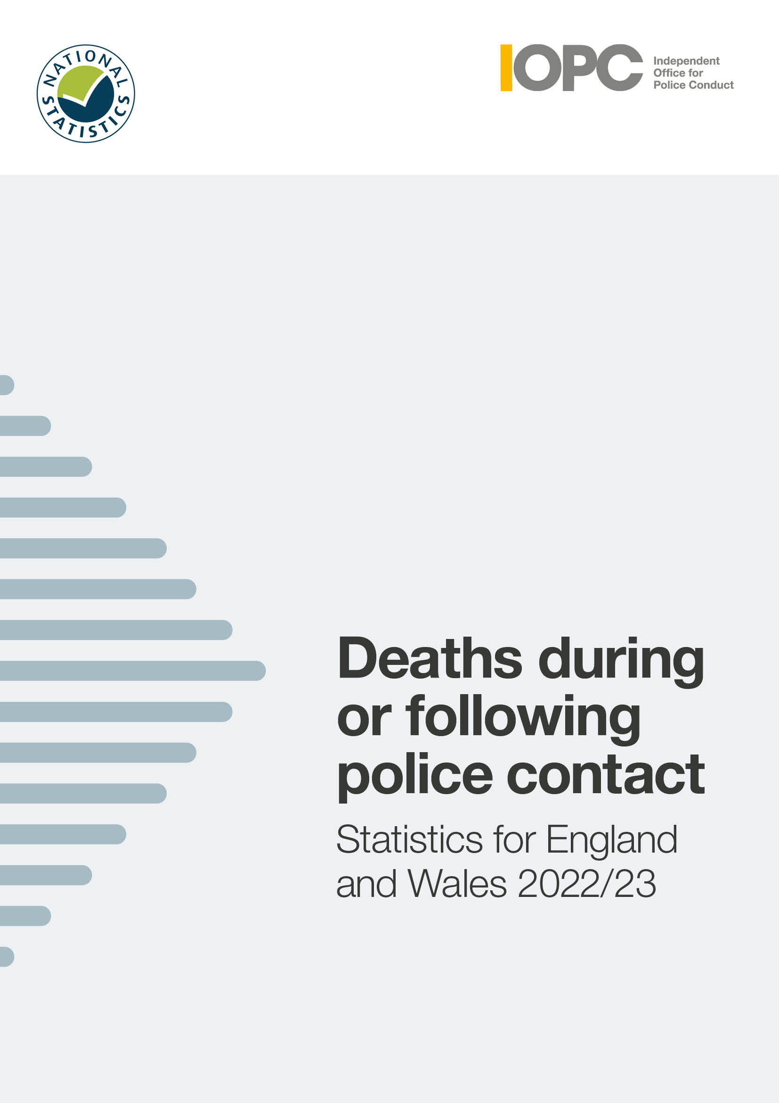
About this report
This report sets out the figures on deaths during or following police contact that happened between 1 April 2022 and
31 March 2023.
It covers the figures for England and Wales, and includes an overview of the nature and circumstances in which these deaths occurred.
It is the nineteenth annual report on deaths during or following police contact published by the IOPC, formerly the Independent Police Complaints Commission.

Slide 3
Introduction
To produce these statistics, we examine the circumstances of all deaths that are referred to us. We decide whether the deaths meet the criteria for inclusion in this report under one of the following categories:
road traffic fatalities
fatal shootings
deaths in or following police custody
apparent suicides following police custody
other deaths following police contact that were subject to an
independent investigation
Notes:
Police forces have a statutory duty to refer all incidents involving a death or serious injury to us.
This report is part of our statutory remit and highlights the importance of having in place robust systems of investigation, learning and accountability, which follow deaths following contact with police

Slide 4

National statistics
The UK Statistics Authority has designated these statistics as National Statistics.
This designation means that the statistics:
meet identified user needs
are well explained and readily accessible
are produced according to sound methods
are managed impartially and objectively in the public interest

Slide 5
Overall findings
During 2022/23, in each category there were:
  28 road traffic fatalities
  3 fatal police shootings
  23 deaths in or following police custody
  52 apparent suicides following police custody
  90 other deaths following police contact that were independently investigated by the IOPC

Slide 6
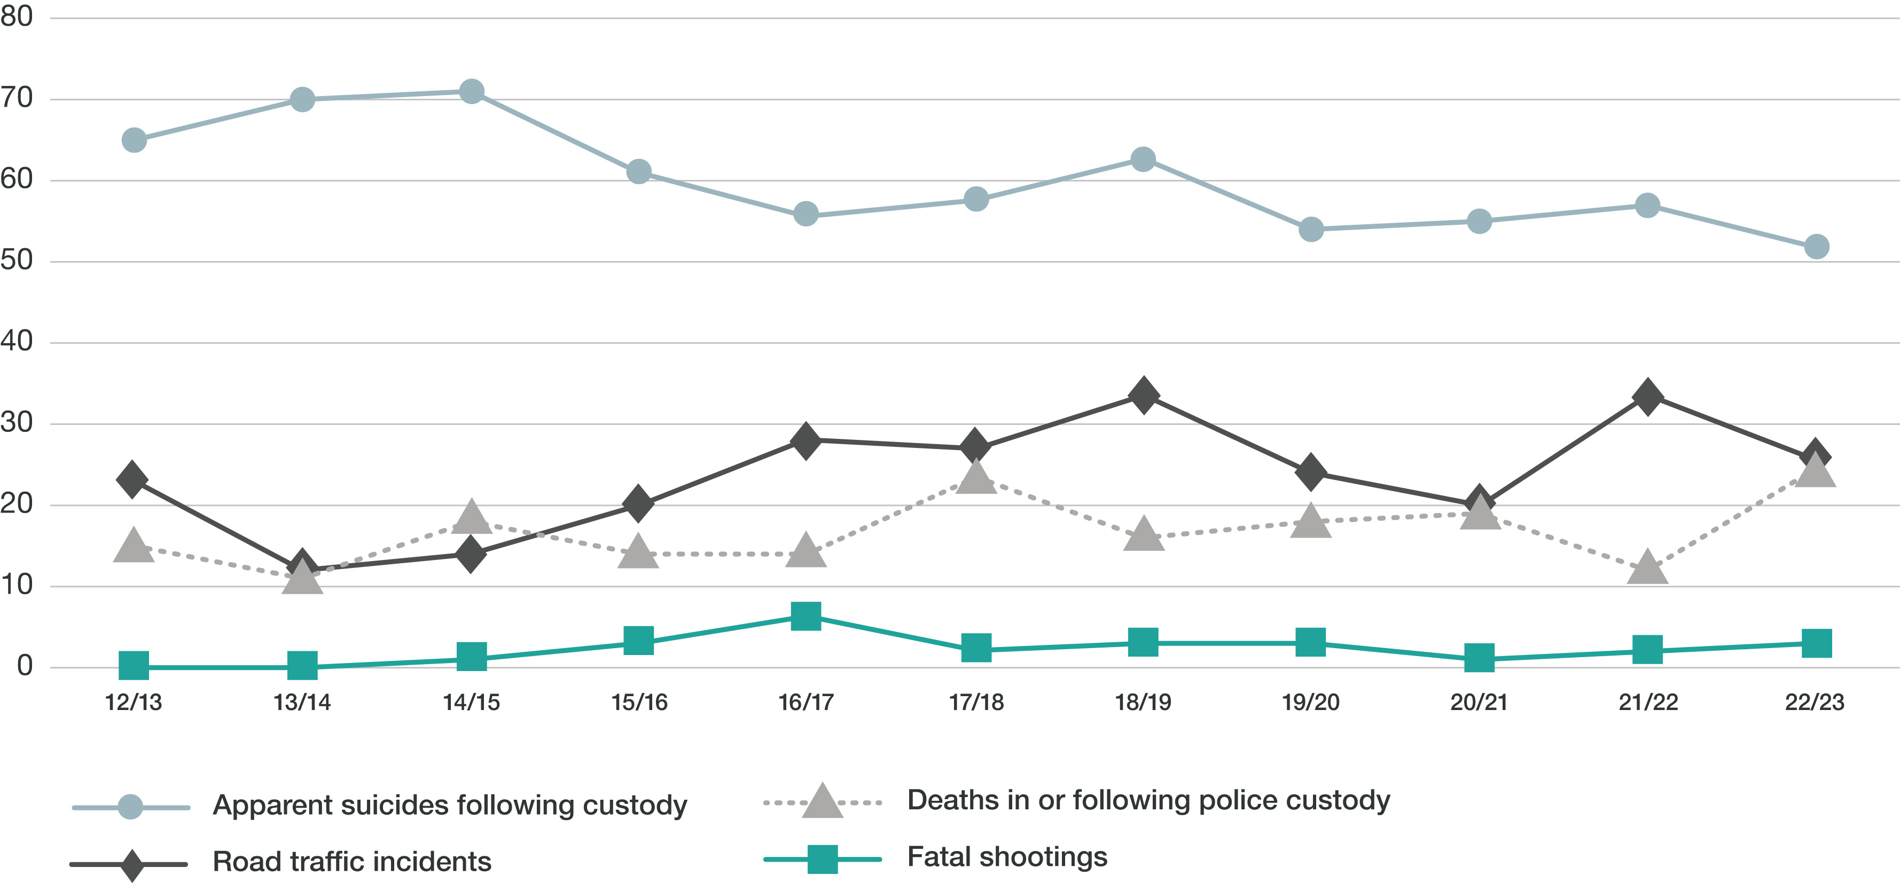
Fig 2.1: Incidents by type of death and financial year, 20212/13 to 2022/23
Notes:
This graph shows the change in numbers of incidents by type of death from 2012/13 to 2022/23 We will explore this further as we go through the next few slides.

Slide 7
Key findings
Deaths in or following police custody
This year, there were 23 deaths in or following police custody. This is higher than the average over the 11-year period and is the highest figure since 2017/18 when there were 23 deaths.
  Eleven people had some force used against them by officers or by members of the public before their deaths, although the use of force did not necessarily contribute to their death.
  Of the 23 deaths in or following police custody, nineteen people were White, two people were Black, one person was of Mixed ethnicity and one person was Asian.
  Three deaths took place in a police custody suite. There were no apparent suicides while in a police custody suite.
Notes:
Between 2004/05 and 2008/09, there was a year-on-year reduction in the number of deaths in or following police custody. These deaths reduced from 36 in 2004/05 to 15 deaths in 2008/09. Over the next two years, the number of deaths in custody increased to 21 in 2010/11, before reducing to 15 in 2011/12 and 2012/13. There was a further reduction in 2013/14 to 11.
In 2014/15, the number rose again to 18 and then declined and remained stable at 14 in 2015/16 and 2016/17. In 2017/18 there were 23 fatalities, the highest number recorded for 10 years. This number fell to 17 fatalities in 2018/19 and increased slightly to 18 in 2019/20. In 2020/21 the number increased slightly again to 19, and then fell notably to 11 in 2021/22. This year, the number of deaths in or following police custody increased again, to 23. This is double the figure recorded the previous year, and slightly higher than the average recorded since figures began in 2004/05.
This year, no one died after making an apparent suicide attempt while in a police custody suite. The last incident of this kind was in 2016/17. Before that, there was one incident in 2014/15 and one in 2008/09. Since 2004/05, seven people are known to have died as a result of self-inflicted acts while in a police cell.
This year three people were pronounced dead in a police cell, the same figure as in 2021/22 and 2020/21. In 2019/20, one person died in a police cell. In 2018/19, no one died in a police cell and in 2017/18 there were three such deaths.

Slide 8
Key findings
Road traffic incidents
This year, there were 26 fatal police-related road traffic incidents (RTIs), resulting in 28 fatalities. Last year, there were 33 fatal RTI incidents. This is in line with the average recorded over the
19-year period since 2004/05 when these statistics were first published. It is the lowest number
of incidents since 2020/21, when there were 20 RTIs.
Of the 28 fatalities, 20 resulted from pursuit-related activity. The number of pursuit-related fatalities has decreased this year, and is in line with the average seen over the past 11 years.
There was one pursuit-related incident that resulted in multiple fatalities (one incident accounted
for three fatalities).
Of the 20 fatalities – twelve were the driver or passenger in the pursued vehicle, one person was
a pedestrian who was hit by the pursued vehicle and five were in an unrelated vehicle. One person was hit by a police vehicle when fleeing a pursuit on foot (they may have been the driver of the pursued vehicle) and one person was in a vehicle being pursued when it crashed, but we have not been able to confirm whether they were the driver or the passenger.
Notes:
This year, 28 people died in 26 separate incidents. There was a decrease in fatalities this year from 40 to 28. This is in line with the average recorded over the 19 years since we first published these statistics. The annual figures fluctuate, and year-on-year comparisons should be approached with caution.
This year there was a decrease in the number of pursuit-related incidents. The number of pursuit-related incidents is in line with the average seen over the past 11 years.
There was also a notable decrease in the number of pursuit-related fatalities this year, from 34 to 20. This year saw a decrease in the number of pursuit-related incidents that resulted in multiple fatalities. One incident accounted for three fatalities. This is the lowest number of pursuit-related incidents that resulted in multiple fatalities since 2019/20, which saw no such incidents. The number of pursuit-related fatalities this year has reduced to the number seen in 2020/21 (20).

Slide 9
Key findings
Road traffic incidents
There were two emergency response related incidents and fatalities.
This is a decrease compared to the three recorded last year, but remains in line with the average number of incidents and fatalities since 2004/05.
There were six ‘other’ police traffic incidents and fatalities. All six happened when a vehicle responded to the presence of the police.
The average age of the people who died was 31. This decreases to 28 if the deceased was the driver or passenger in the pursued or fleeing vehicle. It increases to 37 if the deceased was a pedestrian, cyclist, or a driver or passenger in a vehicle hit by either the police or the pursued or fleeing vehicle.
Notes:
This year has seen a decrease in the number of emergency response-related incidents and fatalities, although the figures for this year are in line with the average number of incidents and fatalities since 2004/05. The number of incidents resulting from other police traffic activity has doubled compared to the previous year. It is slightly higher than the average over the past 11 years, but just over a third of the number recorded in 2004/05

Slide 10
Key findings
Shootings
This year there were three fatal shootings. One of the deceased was Black. All three incidents were subject to independent investigation, one of which is ongoing.
This is up slightly from the two shootings in 2021/22, but in line with the average figure recorded since 2004/05.

Slide 11
Key findings
Apparent suicides following police custody
The number of recorded apparent suicides following custody was 52, lower than the 57 recorded in 2021/22. The number of deaths remains higher than the average before 2012/13.
Twenty-six (50%) of those who died had been arrested for an alleged sexual offence – of these, 24 of the deaths (46%) involved offences against children. These proportions are lower than the figures recorded last year (53% and 47% respectively), but higher than average figures.
Notes:
Apparent suicides following time in police custody are included if they take place within two days of the person’s release from custody. They are also included if experiences in custody may have been relevant to the death, and the death has been referred to us. Reporting of these deaths relies on police forces making the link between an apparent suicide and someone having spent time in custody recently. Increases in these deaths may therefore be influenced by improved identification and referral of such cases.
The number of apparent suicides following time in police custody is lower than the 57 recorded in 2021/22. It is the sixth lowest number recorded over the 19-year period since 2004/05.
This year, for 50% of fatalities, the reason for detention related to alleged sexual offences. The proportion of sexual offences or indecent images involving children was 46%. These proportions are higher than the figures recorded last year (53% and 47% respectively) and higher than average figures. The average proportions for these alleged offences since 2004/05 are 35% and 29% respectively.

Slide 12
Key findings
Other deaths following police contact – independent investigations only
The IOPC independently investigated the deaths of 90 people who died during or following other contact with the police, a decrease from 111 in 2021/22.
The number of deaths that are recorded in this category is directly impacted by our approach to conducting independent investigations. This is because this report category only includes deaths that have been independently investigated. Any change in this category does not necessarily indicate an increase or decrease in the number of people who have died following some form of contact with the police.
Notes:
In 2010/11, a change was made to the definition of this category. It now includes only those deaths following police contact that were investigated independently by the IOPC, previously the IPCC.
During 2014/15, the IPCC started a significant period of change and expansion in response to the then Home Secretary’s announcement that there should be more independent investigations into serious and sensitive matters. This had a direct impact on the number of deaths we recorded in the ‘other deaths following police contact’ category because inclusion of this type of case in this annual report is based on them being independently investigated. Any increase in this category does not, therefore, necessarily indicate an increase in the number of people who have died following some form of contact with the police.
In 2018/19 the IOPC began a phased move to thematic case selection.
The thematic areas include domestic abuse, RTIs, abuse of authority for sexual or financial gain, mental health, near misses in custody and discrimination. Thematic case selection involves independently investigating more cases where these themes may be a factor. This will enable us to develop a body of evidence for learning and prevention work. The move to thematic case selection may have an impact on the number and proportion of cases involving particular circumstances of death – such as concerns for welfare based on mental health, or domestic-related incidents.

Slide 13
Key findings
Other deaths following police contact – independent investigations only
There were 85 fatalities following contact with the police, either directly or indirectly, after concerns were raised about someone’s welfare – of these,
20 related to a report of a missing person. The police generally did not have direct contact with the deceased in these circumstances. Of these, twelve people were also identified as at risk of self-harm or suicide.
Of these 85 fatalities, 15 were linked to domestic incidents/concerns. For this type of contact with the police, women accounted for a higher proportion than they did in the other deaths in or following police contact categories that were investigated independently.

Slide 14
Key findings
Other deaths following police contact – independent investigations only
During 2022/23, 18% of investigations into deaths following police contact related to incidents where someone had reported their concern about a person’s risk of self-harm, risk of suicide, or mental health. This is slightly lower than in 2021/22.
Seventeen per cent of investigations into deaths following police contact were domestic-related. These two types of concern for welfare are part of our thematic work areas. This may result in the number of these types of investigations increasing and/or forming a larger proportion of the ‘other contact’ deaths that the IOPC independently investigates.
Notes:
The overall proportion of cases relating to a concern for welfare made up 94% of the deaths following police contact that were independently investigated – a slightly higher proportion than the 90% 2021/22

Slide 15
Key findings
Alcohol, drugs and mental health
As in previous years, mental health and links to drugs or alcohol were common factors among many of those who died.
Thirteen of 23 people who died in or following police custody had mental health concerns.
Twenty-one people who died in or following police custody had links to drugs and/or alcohol.
Almost two-thirds (55) of those who died following other police contact were reported to be intoxicated with drugs and/or alcohol at the time of the incident, or it featured heavily in their lifestyle. A similar proportion (57) were reported to have mental health concerns.
Sixteen fatalities following other police contact related to concern about a person’s risk of self-harm, suicide, or their mental health. A further twelve people were reported to the police as missing, with a specific risk of self-harm or suicide.
Notes:
Vulnerabilities we have seen year after year continue to be prevalent among those who died, with twenty-one people who died in or following police custody having had links to alcohol and/or drugs and thirteen having had mental health concerns. Of the 90 other deaths we independently investigated, the majority had contact with police because of concerns for their welfare and almost half were reported to be intoxicated or affected by substance abuse.
These are system-wide issues which need a concerted response to help prevent future deaths from occurring.
Not all of the deaths will be preventable, but it is vital that work across agencies continues. We need to ensure police custody is as safe as possible, to better train officers to de-escalate in conflict situations where feasible, to keep embedding learning into police practice promptly, and to make sure that appropriate health and social services are available alongside the police service to meet the needs of those in crisis.
With our continued focus on prevention, we have issued 78 learning recommendations from our investigations and reviews following deaths in the past three years.

Slide 16
Key findings
Use of force
Eleven of the 23 people who died in or following police custody had some force used against them by the police or others before their deaths. Ten out of the 11 people were restrained. Three incidents involved discharge of a Taser.
Of the 90 ‘other deaths following police contact’, there were six that involved restraint or other use of force. Five were restrained and one person was subject to discharge of a Taser. The use of force did not necessarily contribute to the death.
Of the eleven ‘deaths in or following custody’, that involved use of force, eight were White, one was Black, one was of Mixed ethnicity and one person was Asian.
Of the six ‘other contact deaths’, that involved use of force, four people were White and two were Black.

Slide 17
To find out more
Our full report is available on our website.
If you have difficulties accessing our report please email: content_design_team@policeconduct.gov.uk
For any questions or comments about our report or the statistics please email:
research@policeconduct.gov.uk
Website: www.policeconduct.gov.uk
Twitter: @policeconduct
Email: enquiries@policeconduct.gov.uk
Phone: 0300 020 0096

