Slide 1
Annual deaths during or following police contact: Statistics for England and Wales 2023/24
Report summary
17 October 2024

Slide 2
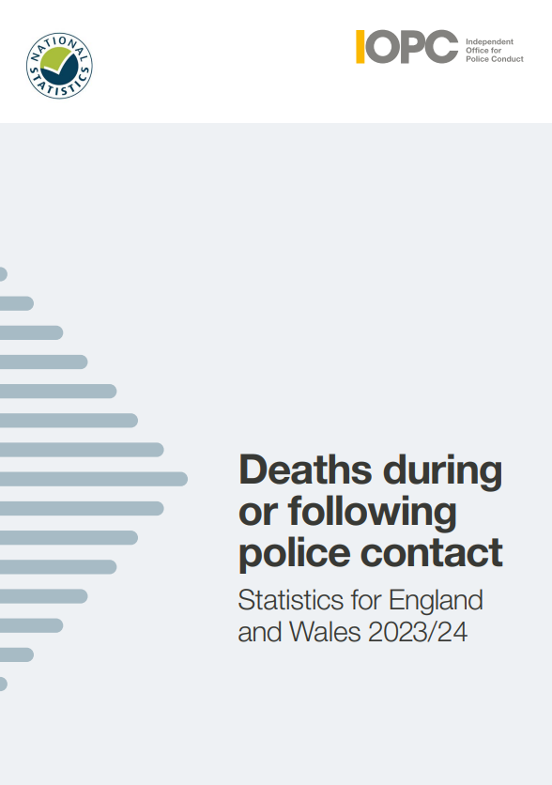
About this report
This report sets out the figures on deaths during or following police contact that happened between 1 April 2023 and 31 March 2024.
It covers the figures for England and Wales, and includes an overview of the nature and circumstances in which these deaths occurred.
It is the twentieth annual report on deaths during or following police contact published by the IOPC, formerly the Independent Police Complaints Commission.

Slide 3
Introduction
To produce these statistics, we examine the circumstances of all deaths that are referred to us. We decide whether the deaths meet the criteria for inclusion in this report under one of the following categories:
road traffic fatalities
fatal shootings
deaths in or following police custody
apparent suicides following police custody
other deaths following police contact that were subject to an independent investigation
Notes:
Police forces have a statutory duty to refer all incidents involving a death or serious injury to us.
This report is part of our statutory remit and highlights the importance of having in place robust systems of investigation, learning and accountability, which follow deaths following contact with police.

Slide 4

National statistics
The UK Statistics Authority has designated these statistics as National Statistics.
This designation means that the statistics:
meet identified user needs
are well explained and readily accessible
are produced according to sound methods
are managed impartially and objectively in the public interest

Slide 5
Overall findings
During 2023/24 there were:
32 road traffic fatalities
2 fatal police shootings
24 deaths in or following police custody
68 apparent suicides following police custody
60 other deaths following police contact that were independently investigated by the IOPC

Slide 6
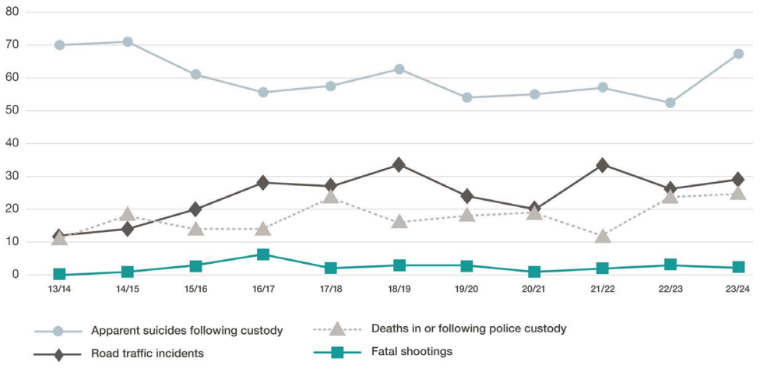
Fig 2.1: Incidents by type of death and financial year, 2013/14 to 2023/24
Notes:
This graph shows the change in numbers of incidents by type of death from 2013/14 to 2023/24.
We will explore this further as we go through the next few slides.

Slide 7
Key findings
Deaths in or following police custody
This year, there were 24 deaths in or following police custody. This is higher than the average of 17 deaths over the 11-year period since 2013/14 and is the highest figure since 2006/07 when there were 27 deaths.
Fourteen people had some force used against them by officers or by members of the public before their deaths, although the use of force did not necessarily contribute to their death.
Of the 24 deaths in or following police custody, twenty-one people were White, one person was Black, one person was of Mixed ethnicity and one person was of an other ethnicity.
This year four people were pronounced dead in a police cell, one more than in 2022/23. One person died after making an apparent suicide attempt while in a police custody suite. The last incident of this kind was in 2016/17.
Notes:
Between 2004/05 and 2008/09, there was a year-on-year reduction in the number of deaths in or following police custody. These deaths reduced from 36 in 2004/05 to 15 deaths in 2008/09. Over the next two years, the number of deaths in custody increased to 21 in 2010/11, before reducing to 15 in 2011/12 and 2012/13. There was a further reduction in 2013/14 to 11.
In 2014/15, the number rose to 18 and then declined and remained stable at 14 in 2015/16 and 2016/17. In 2017/18 there were 23 fatalities, the highest number recorded for ten years. This number fell to 17 fatalities in 2018/19 and increased slightly to 18 in 2019/20. In 2020/21 the number increased slightly to 19, fell notably to 11 in 2021/22, before increasing notably to 23 in 2022/23.
This year, the number of deaths in or following police custody increased, to 24. The 2023/24 figure is higher than the average of 17 deaths over the 11-year period since 2013/14.
This year, one person died after making an apparent suicide attempt while in a police custody suite. The last incident of this kind was in 2016/17. Before that, there was one incident in 2014/15 and one in 2008/09. Since 2004/05, eight people are known to have died as a result of self-inflicted acts while in a police cell.
This year four people were pronounced dead in a police cell, one more than in 2022/23, 2021/22 and 2020/21. In 2019/20, one person died in a police cell. In 2018/19, no one died in a police cell. In 2017/18 there were three such deaths.

Slide 8
Key findings
Road traffic incidents
This year, there were 29 fatal police-related road traffic incidents, resulting in 32 fatalities. Last year, there were 26 fatal road traffic incidents. This year’s figures are above the average of 27 road traffic incident fatalities recorded over the 11-year period since 2013/14.
Of the 32 fatalities, 24 resulted from pursuit-related activity. The number of pursuit-related fatalities has increased this year, and is higher than the average of 20 pursuit-related deaths seen over the past 11 years.
There were two pursuit-related incidents that resulted in multiple fatalities (two incidents accounted for four fatalities, with two fatalities in each incident).
Of the 24 fatalities – eighteen were the driver or passenger in the pursued vehicle, one person was a pedestrian who was hit by the pursued vehicle and four were in an unrelated vehicle. One person was a pedestrian who was hit by a police vehicle in pursuit.
Notes:
This year, 32 people died in 29 separate incidents. There was an increase in fatalities this year from 28 to 32. This is above the average of 27 road traffic incident fatalities recorded over the 11-year period since 2013/14. The annual figures fluctuate, and year-on-year comparisons should therefore be approached with caution.
This year there was an increase in the number of pursuit-related incidents. The number of 22 pursuit-related incidents is higher than the average of 17 incidents seen over the past 11 years.
There was an increase in the number of pursuit-related fatalities this year, from 20 to 24. There was also an increase in the number of pursuit-related incidents that resulted in multiple fatalities. Two incidents accounted for four fatalities, with two fatalities in each incident. The number of pursuit-related fatalities this year is higher than the average of 20 fatalities recorded over the 11-year period since 2013/14.
This year has seen a decrease in the number of emergency response-related incidents and fatalities. The figures of one incident and one fatality for this year, are lower than the average of two incidents and two fatalities since 2013/14.

Slide 9
Key findings
Road traffic incidents
There was one emergency response related incident and fatality. This is a decrease compared to the two recorded last year. This is lower than the average of two incidents and two fatalities since 2013/14.
The number of six incidents resulting from other police traffic activity has stayed the same as in the previous year, with the number of fatalities increasing by one. Two incidents happened when a vehicle responded to the presence of the police, two involved a pedestrian being hit by police, one involved a non-pursuit vehicle hitting a police vehicle and one incident happened while the police were on driving duties.
The average age of the people who died was 34. This decreases to 25 if the deceased was the driver or passenger in the pursued or fleeing vehicle. It increases to 46 if the deceased was a pedestrian, cyclist, or a driver or passenger in a vehicle hit by either the police or the pursued or fleeing vehicle. Seven of those who died were under 18, compared to none in 2022/23.
Notes:
This year has seen a decrease in the number of emergency response-related incidents and fatalities. The figures of one incident and one fatality for this year, are lower than the average of three incidents and three fatalities since 2004/05.
The number of six incidents resulting from other police traffic activity has stayed the same as in the previous year, with the number of fatalities increasing by one. It is higher than the average of five incidents and five fatalities over the past 11 years, but approximately a third of the number of incidents recorded in 2004/05.

Slide 10
Key findings
Shootings
This year there were two fatal shootings. Both of the deceased were White. Both incidents were subject to independent investigation, one of which is ongoing.
This is down from the three shootings in 2022/23, and lower than the average of three shootings recorded since 2013/14.

Slide 11
Key findings
Apparent suicides following police custody
The number of recorded apparent suicides following custody was 68, higher than the 54 recorded in 2022/23. The number of deaths remains higher than the average before 2012/13 and is the highest number of suicides since 2014/15 when there were 71.
Thirty-one (46%) of those who died had been arrested for an alleged sexual offence – of these, 26 of the deaths (38%) involved offences against children. These proportions are lower than the figures recorded last year (50% and 46% respectively), but higher than average figures.
Notes:
Apparent suicides following time in police custody are included if they take place within two days of the person’s release from custody. They are also included if experiences in custody may have been relevant to the death, and the death has been referred to us. Reporting of these deaths relies on police forces making the link between an apparent suicide and someone having spent time in custody recently. Increases in these deaths may therefore be influenced by improved identification and referral of such cases.
The number of apparent suicides following time in police custody is higher than the 54 recorded in 2022/23. It is the highest number of suicides since 2014/15 when there were 71. Reporting of these deaths relies on police forces making the link between an apparent suicide and someone spending time in custody recently. Increases or decreases in these deaths may therefore be influenced by identification and referral of such cases.
This year, for 46% of fatalities, the reason for custody related to alleged sexual offences. The proportion of sexual offences or indecent images involving children was 38%. These proportions are lower than the figures recorded last year (50% and 46% respectively) but higher than average figures. The average proportions for these alleged offences since 2004/05 are 36% and 30% respectively

Slide 12
Key findings
Other deaths following police contact – independent investigations only
The IOPC independently investigated the deaths of 60 people who died during or following other contact with the police, a decrease from 91 in 2022/23.
The number of deaths that are recorded in this category is directly impacted by our approach to conducting independent investigations. This is because this report category only includes deaths that have been independently investigated. Any change in this category does not necessarily indicate an increase or decrease in the number of people who have died following some form of contact with the police.
Notes:
Since 2010/11, this category has only included deaths where there has been an independent investigation, or where one is ongoing. This is to improve consistency in the reporting of these deaths.
During 2014/15, the IPCC started a significant period of change and expansion in response to the then Home Secretary’s announcement that there should be more independent investigations into serious and sensitive matters. This had a direct impact on the number of deaths we recorded in the ‘other deaths following police contact’ category because inclusion of this type of case in this annual report is based on them being independently investigated. Any increase in this category does not, therefore, necessarily indicate an increase in the number of people who have died following some form of contact with the police.
In 2018/19 the IOPC began a phased move to thematic case selection. The thematic areas include domestic abuse, road traffic incidents, abuse of authority for sexual or financial gain, mental health, near misses in custody and discrimination. Thematic case selection involves independently investigating more cases where these themes may be a factor. This will enable us to develop a body of evidence for learning and prevention work. The move to thematic case selection may have an impact on the number and proportion of cases involving particular circumstances of death – such as concerns for welfare based on mental health, or domestic-related incidents.

Slide 13
Key findings
Other deaths following police contact – independent investigations only
There were 51 fatalities following contact with the police, either directly or indirectly, after concerns were raised about someone’s welfare – of these, two related to a report of a missing person. The police generally did not have direct contact with the deceased in these circumstances.
Of these 51 fatalities, 13 were linked to domestic incidents/concerns. For this type of contact with the police, women accounted for all 13 deaths.
Seventeen fatalities were related to the person’s health, possible injuries, intoxication, or general well-being. A third party contacted the police to raise concern in most incidents.
Fifteen fatalities related to incidents where someone had reported their concern about a person’s risk of self-harm, risk of suicide, or mental health.
Four people died following concern about threatening behaviour. These incidents involve threatening behaviour or harassment among people in non-domestic situations, such as between neighbours or strangers.
Notes:
The overall proportion of cases relating to a concern for welfare made up 85% of the deaths following police contact that were independently investigated – lower proportion than in 2022/23.

Slide 14
Key findings
Other deaths following police contact – independent investigations only
Nine (15%) investigations into deaths following police contact related to other types of contact.
Three people died after police officers attended a report of a disturbance.
Two people died in an attempt to avoid police contact or arrest.
Two people died in one incident during a siege situation with the police.
One person died after contact with the police who were conducting investigation enquiries.
One person died following other contact with the police.

Slide 15
Key findings
Mental health, alcohol and drugs
As in previous years, mental health and links to drugs or alcohol were common factors among many of those who died.
Nineteen of 24 people who died in or following police custody had mental health concerns.
Twenty-one people who died in or following police custody had links to drugs and/or alcohol.
Just under half of those who died following other police contact were reported to be intoxicated by drugs and/or alcohol at the time of the incident, or it featured heavily in their lifestyle (29); a similar proportion of the people who died were reported to have mental health concerns (27).
Fifteen fatalities following other police contact related to concern about a person’s risk of self-harm, suicide, or their mental health.
Of the 68 apparent suicides, 48 people had known mental health concerns and 31 had links to drugs and/or alcohol.
Notes:
Vulnerabilities we have seen year after year continue to be prevalent among those who died, with twenty-one people who died in or following police custody having had links to alcohol and/or drugs, and nineteen having had mental health concerns – this is the highest ever number of deaths in custody that involved mental health concerns. Of the 60 other deaths we independently investigated, vast majority had contact with police because of concerns for their welfare and almost half (29) were reported to be intoxicated or affected by substance abuse.
These are system-wide issues which need a concerted response to help prevent future deaths from occurring.
Not all of the deaths will be preventable, but it is vital that work across agencies continues. We need to ensure police custody is as safe as possible, to better train officers to de-escalate in conflict situations where feasible, to keep embedding learning into police practice promptly, and to make sure that appropriate health and social services are available alongside the police service to meet the needs of those in crisis.

Slide 16
Key findings
Use of force
Fourteen of the 24 people who died in or following police custody had some force used against them by the police or others before their deaths. All fourteen of the people were restrained. One of restraint incidents also involved use of PAVA incapacitant spray.
Of the 60 ‘other deaths following police contact’, there were eight that involved restraint or other use of force. Five were restrained, two people were subject to discharge of a Taser and one had PAVA incapacitant spray used against them. The use of force did not necessarily contribute to the death.
Of the fourteen ‘deaths in or following custody’, that involved use of force, thirteen of the deceased were White and one was of Mixed ethnicity,
Of the eight ‘other contact deaths’, that involved use of force, six of the deceased were White and two were Black.
Notes:
Restraint is recorded as a factor if a person was physically restrained at some point between the initial contact with police and their death. Restraint is reported on in the report if it involved restraint by police officers or police staff and it will be detailed separately if restraint was by civilians only during police contact.
Restraint includes the manual restraint of the deceased or the use of restraint equipment such as leg restraints; it does not include handcuffs. Stating that a case involved restraint does not mean that the restraint was considered to be a contributory factor to the cause of death. Restraint can be recorded as a factor on deaths that occur in or following police custody or those that follow other police contact.
When the cause of death was presented in a table in the report, if the restraint was identified as being a contributory factor, as stated by the pathologist or at inquest, then the cause of death was listed as ‘restraint-related’ in the annual statistics. Restraint was either listed as a primary or secondary cause of death based on the findings of the pathologist. Since then, as noted above, cause of death is now written out in full as used in the post-mortem (or inquest) reports.
In 2011/12, we started routinely recording data relating to the use of Taser stun guns and incapacitant spray by the police on cases involving a death. Where applicable, more detailed data was also collected on the type and method of restraint.
In 2015/16, in addition to recording data on Taser stun guns and incapacitant spray, the we started documenting data relating to all types of force used by the police including the use of batons, conventional firearms and police dogs.

Slide 17
To find out more
Our full report is available on our website. If you have difficulties accessing our report please email: content_design_team@policeconduct.gov.uk
For any questions or comments about our report or the statistics please email: research@policeconduct.gov.uk
Website: www.policeconduct.gov.uk Twitter: @policeconduct Email: enquiries@policeconduct.gov.uk Phone: 0300 020 0096

